Slide 1
Blanco y Verde
Noah Ledesma

Slide 2
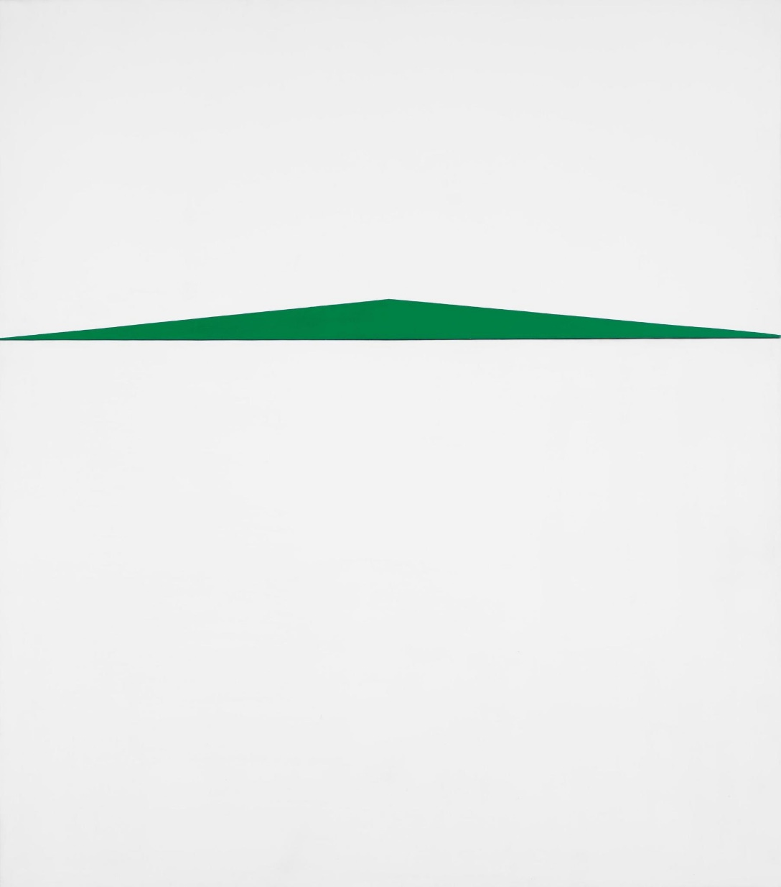
Carmen Herrera
Blanco y Verde
1959
68 ⅛ × 60 ½ in.
Acrylic on canvas
Purchased with funds from the Painting and Sculpture Committee of the Whitney Museum of American Art.
Accession number: 2014.63
The painting is composed of a short, solid green triangle. Each of the three sides are perfectly straight. The base of the triangle rests about a third of the way up the canvas, the sides are stretched across the width, and the apex points toward the middle-top. Above and below the triangle is solid white.

Slide 3
Biography
Carmen Herrera was born in 1915 in Havana, Cuba. There she began her studies in architecture, which ignited her lifelong love for straight lines, although she soon turned her focus to painting. During her "Parisian sojourn" from 1948 to 1954, she was exposed to a myriad of European influences that fostered and cultivated the development of her signature abstract minimalist style. However, upon settling in New York in 1954, her hard-edged geometric work was largely ignored amidst the wave of Abstract Expressionism. Herrera was excluded from the American art canon, owing to her being a woman of Cuban descent. Nevertheless her love for painting fueled her work, and she continued to labor in relative obscurity for decades. Finally, she was discovered by the art world in her late 80's, and a string of exhibitions launched her into long-awaited and well-deserved acclaim.

Slide 4
Exhibition Record
1933 - ‘Exposición de Autorretratos’, Círculo de Bellas Artes, Havana, Cuba
1937 - ‘Primera Exposición de Arte Moderno, Pintura y Escultura’, Salones del Centro de Dependientes, Havana, Cuba
1949-1953 - ‘Salon des Réalités Nouvelles’, Palais des Beaux-Art de la Ville de Paris, France
1955 - Eglinton Gallery, Toronto, Canada
1965 - Cisneros Gallery, New York, NY, USA
1968 - ‘Five Latin American Artists at Work in New York’, Center for Inter-American Relations, New York, NY, USA
1973 - ‘Women Choose Women’, New York Cultural Center, New York, NY, USA
1979 - Institute of International Education, New York, NY, USA
1986 - ‘Two Minimalists Four Decades Apart’ (with Elizabeth Poverono), Rastovski Gallery, New York, NY, USA
1998 - ‘The Black and White Paintings, 1951-1959’, El Museo del Barrio, New York, NY, USA
2005 - ‘The Forms of Silence: Carmen Herrera Abstract Works 1948-1976’, Miami Art Central, Miami, FL, USA
2009 - ‘Carmen Herrera,’ Ikon Gallery, Birmingham, UK
2010 - Museum Pfalzgalerie Kaiserslautern, Kaiserslautern, Germany
2012 - ‘The Geometric Unconscious: A Century of Abstraction’, Sheldon Museum of Art, Lincoln, NE, USA
2016 - ‘Carmen Herrera: Lines of Sight’, Whitney Museum of American Art, New York NY, USA
2017 - ‘Carmen Herrera’, Lisson Gallery, London, UK
2018 - ‘Carmen Herrera: Estructuras’, Lisson Gallery, New York, NY, USA
2019 - ‘Carmen Herrera: Estructuras Monumentales', Public Art Fund, City Hall Park, New York, NY, USA

Slide 5
Label
Squinting into the noonday sun, lift your eyes to a green hilltop resting on the horizon. Bright rays fill the sky, and reflect onto the still lake before you. Encompassed by the wet, Cuban summer heat, you've just seen the world through the eyes of the abstract artist Carmen Herrera. This piece is a product of what she describes as her “lifelong process of purification, a process of taking away what isn’t essential,” no doubt informed by her studies in architecture at the University of Havana in the city of her birth. In this entry in her series Blanco y Verde, Herrera has expertly reduced this scenic experience to its bare essence.

Slide 6
Questions for the artist
Was the Blanco y Verde series based on any specific environment?
Is there a particular artist or movement that has had the biggest influence on your work?
Would you have stayed in Paris if you could have?
How would you describe your work?
To what/who do you attribute your “discovery”?
Do you have any advice for aspiring artists whose work isn’t noticed?

Slide 7
Works Cited
“Blanco y Verde.” Whitney Museum of American Art, Whitney Museum of American Art, whitney.org/collection/works/45126.
Indrisek, Scott. “Nothing More, Nothing Less.” Modern Painters, vol. 28, no. 6, June
2016, pp. 84–91. EBSCOhost, search.ebscohost.com/login.aspx?direct=true&db=aft&AN=115391667&site=ehost-live.
“Carmen Herrera: Lines of Sight.” Whitney Museum of American Art, Whitney Museum of American Art, whitney.org/Exhibitions/CarmenHerrera.
“Carmen Herrera.” Lisson Gallery, Lisson Gallery London Limited, www.lissongallery.com/artists/carmen-herrera.

